Slide 1
Homework Assignment #3:
List File

Slide 2
Outline
ls
Review
How to deal with the data in struct stat ?
Homework Assignment #3

Slide 3
ls
In computing, ls is a command to list computer files in Unix and Unix-like operating systems.
When invoked without any arguments, ls lists the files in the current working directory.

Slide 4
ls
-l | File detail( permission, time….)
-f | do not sort
-F | appends a character revealing the nature of a file
-a | lists all files in the given directory, including "."
-R | recursively lists subdirectories
-d | shows information about a symbolic link or directory
-t | sort the list of files by modification time
-h | print sizes in human readable format, like 12KB.
-1 | force output to be one entry per line
Notes:
-F，依照檔案性質標示相應符號，EX:目錄(“/”)…
-f 強制不做排序，隨機印出
快速帶過

Slide 5
Outline
ls
Review
How to deal with the data in struct stat ?
Homework Assignment #4

Slide 6
#include <dirent.h>
DIR *opendir(const char *name);
Return a pointer to the directory stream. On error, NULL is returned
struct dirent *readdir(DIR *dirp);
Returns a pointer to a dirent structure
int closedir(DIR *dirp);
Closes the directory stream
Notes:
Include dirent.h
給他一個目錄的位置，他會回傳 directory stream 的 pointer ( type = DIR* )
這個 pointer 後續 readir 和 close 會使用到
假設找不到給定的目錄，會回傳NULL
例如，我給他一個點，代表我要開啟當前目錄

Slide 7
dirent structure
struct dirent {
ino_t d_ino; /* Inode number */
off_t d_off; /* current position in the directory stream.*/
unsigned short d_reclen; /* Length of this record */
unsigned char d_type; /* Type of file; not supported by
all filesystem types */
char d_name[256]; /* filename */
};
Notes:
主要要看的只有紅色標記的，因為他是 standard ，其他項目要看ＯＳ是否support
這個 file 或是 directory 的 inode
他的檔案名稱

Slide 8
dirent structure (cont.)
The following macro constants for the value returned in d_type:
  DT_BLK This is a block device.
  DT_CHR This is a character device.
  DT_DIR This is a directory. 4
  DT_FIFO This is a named pipe (FIFO).
  DT_LNK This is a symbolic link. 10
  DT_REG This is a regular file. 8
  DT_SOCK This is a UNIX domain socket.
  DT_UNKNOWN The file type could not be determined.
Only Btrfs, ext2, ext3, and ext4 have full support for returning the file type in d_type.
Notes:
因為平台是 ext 檔案系統所以可以用
主要透過 這些constant 讓我們去知道，他是 檔案 還是 目錄
Symbolic link是一種檔案的進入點，有點類似捷徑的概念，只要將檔案移位，就無法開啟
Regular file-普通文件
Character device-可循序存取的設備，如印表機
Block device-可隨機存取的設備，如硬碟
Named pipe:用於process間的溝通

Slide 9
Outline
ls
Review
How to deal with the data in struct stat ?
Homework Assignment #4

Slide 10
lstat()
#include <sys/stat.h>
int lstat(const char *path, struct stat *buf);
EX: lstat(file_name,&buf);
DESCRIPTION
  Return information about a file. (in buf)
  No permissions are required on the file itself.
  Execute (search) permission is required on all of the directories in path that lead to the file.
RETURN VALUE
  Returns 0 on success. On error, -1 is returned
Notes:
lstat:去path找檔案，去buf找檔案相關資訊，沒有檔案或是沒有相關資訊，就會return -1

Slide 11
stat structure
struct stat {
dev_t st_dev; /* ID of device containing file */
ino_t st_ino; /* inode number */
mode_t st_mode; /* protection */
nlink_t st_nlink; /* number of hard links */
uid_t st_uid; /* user ID of owner */
gid_t st_gid; /* group ID of owner */
dev_t st_rdev; /* device ID (if special file) */
off_t st_size; /* total size, in bytes */
blksize_t st_blksize; /* blocksize for file system I/O */
blkcnt_t st_blocks; /* number of 512B blocks allocated */
time_t st_atime; /* time of last access */
time_t st_mtime; /* time of last modification */
time_t st_ctime; /* time of last status change */
};

Slide 12
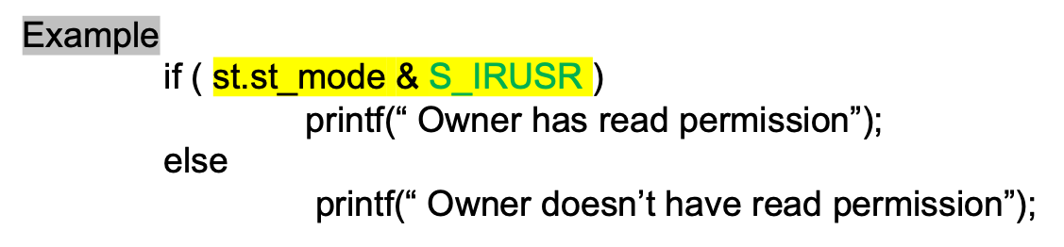
Permission
Flag | Description
S_IRUSR | Owner has read permission 00400
S_IWUSR | Owner has write permission 00200
S_IXUSR | Owner has execute permission 00100
S_IRGRP | Group has read permission 0040
S_IWGRP | Group has write permission 00020
S_IXGRP | Group has execute permission 00010
S_IROTH | Others have read permission 00004
S_IWOTH | Others have write permission 00002
S_IXOTH | Others have execute permission 00001

Slide 13
Owner Name
#include <pwd.h>、 <sys/types.h>
struct passwd *getpwuid(uid_t uid);
EX: struct passwd *user = getpwuid( uid );
printf(”owner name:%s\n", user->pw_name);
DESCRIPTION
  Search the user database for an entry with a matching uid.
RETURN VALUE
  If found, return a pointer to a struct passwd.
  Otherwise, return NULL pointer.

Slide 14
Group Name
#include <grp.h>、<sys/types.h>
struct group *getgrgid(gid_t gid);
EX: strcut group *grp = getgrgid ( gid );
printf(”group name:%s\n", grp->gr_name);
DESCRIPTION
  Search the group database for an entry with a matching gid.
RETURN VALUE
  If success, return a pointer to a struct group.
  Otherwise, return NULL pointer.

Slide 15
Last Modification Time
#include <time.h>
struct tm * localtime(const time_t *timep);
DESCRIPTION
  The value of timer is broken up into the structure tm and expressed in the local time zone.
#include <time.h>
size_t strftime(char *str, size_t maxsize,
const char *format, const struct tm *timeptr)
DESCRIPTION
  Formats the information from timeptr into the buffer str, according to the string pointed to by format.
Notes:
電腦時間是從1970年開始以秒為單位累計，localtime，會將電腦時間，轉換成當地時間
而在strftime中，timeptr是tm架構的指標，包含各種時間ex:tm_sec,tm_min….，str則是會將指定format的時間複製，str本身是指標，因此可以以指標字串印出

Slide 16
Last Modification Time
EX:
struct tm * ptr_time = localtime( &rawtime );
strftime(str, sizeof(str), "%x %H:%M", ptr_time );
printf("Formatted date & time : %s ", str );
Note:
There are more format, like %c and %F, please see the reference.
Notes:
%x:date

Slide 17
Symbolic Link
#include <unistd.h>
ssize_t readlink(const char *path, char *buf, size_t bufsiz);
EX: readlink(path, content, sizeof( content ));
printf("%s",content);
DESCRIPTION
  Place the contents of the symbolic link referred to by path in the buffer buf .
RETURN VALUE
  Return the count of bytes placed in the buffer.
  Otherwise, it shall return a value of -1.
Notes:
Symbolic link會以:/a/b/c/.....形式存在文字檔，readlink則是將此path，存進指定大小content。

Slide 18
Outline
ls
Review
How to deal with the data in struct stat ?
Homework Assignment #3

Slide 19
Homework Assignment #3
Implement a simple program that does like ls.
  It lists all the files in the given directory.
If the user doesn’t specify any directory, start at the current working directory by default.
If the user invoked with “- l “, it should print all information in below format :
  Otherwise, your program just prints the file name only.
Show the path, if the file belongs to a symbolic link.
Permission | Owner | Group | Last Modification Time | Size | Name
-rwxrwxr-x | root | root | 05/20/20 13:14 | 9527 | hw3.c

Slide 20

Homework Assignment #3
Ex1: list the file in the current working directory
Your Program
Using ls

Slide 21
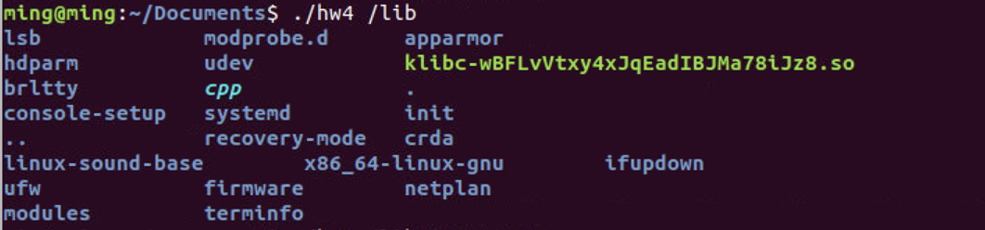
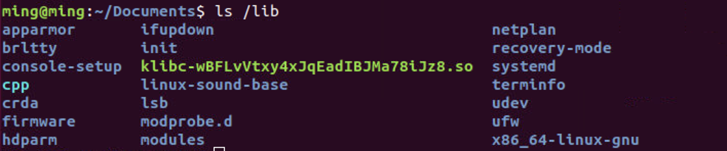
Homework Assignment #3
Ex2: list the file in /boot
Your Program
Using ls

Slide 22
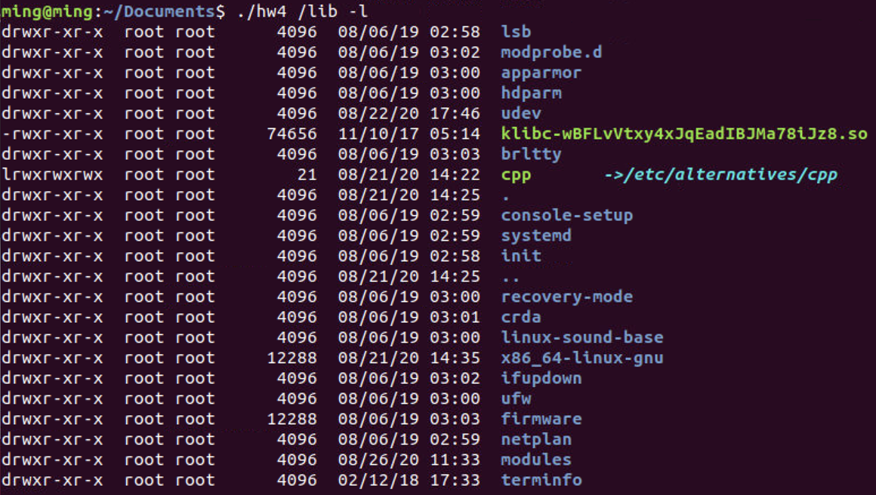
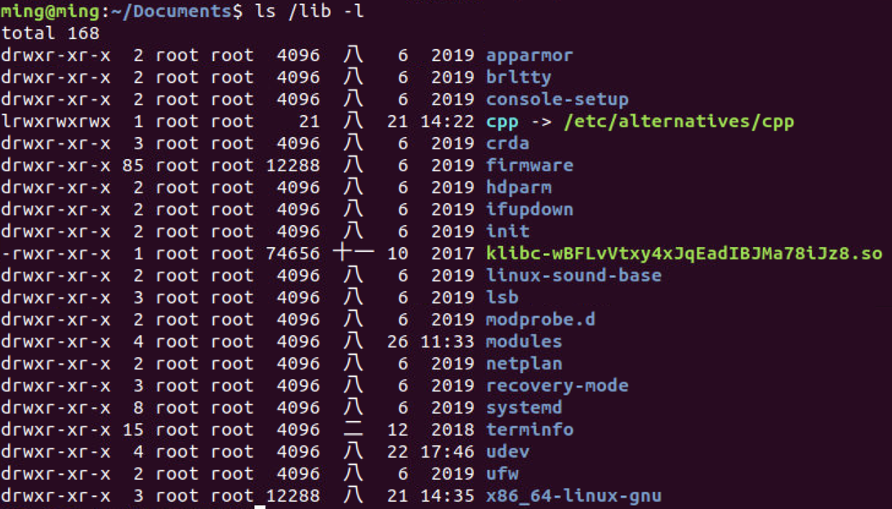
Homework Assignment #3
Ex3: list the file in /lib invoked with “-l”
Your Program
Using ls

Slide 23
Note
Please use Ubuntu 16 or later.
Leave an appropriate comment.

Slide 24
Turn in
Deadline
2021/5/27 23:59:59
Upload to i-learning
File name
    Source code (e.g. HW3.c)
    Word file (e.g. HW3.docx)
If you don’t hand in your homework on time, your score will be deducted 10 points every day.

Slide 25
TA
Name: 黃聖穎
Email: andrew841018@gmail.com
Title format: HW3_[學號](ex:HW3_7109056252)
Lab: OSNET(1001A)

Slide 26

Reference
Websites:
  https://linux.die.net/man/2/lstat
  https://linux.die.net/man/3/getpwuid
  https://linux.die.net/man/3/getgrgid
  https://linux.die.net/man/3/readlink
  https://linux.die.net/man/3/strftime
Book:
  The Linux Programming Interface - A Linux and UNIX System Programming Handbook

Slide 27

ANY QUESTION?

